Slide 1


Price Optimization and Elasticity Analysis
Case Study
By
Karthika Manoj

Slide 2
Price Optimization and Elasticity Analysis
Objective:
Analyze the impact of pricing strategies on demand to optimize sales and inventory levels.
Understand how discounting and promotions influence customer purchase behavior.
Data:
Fields: Retail price, sale price, availability, promotions, review rating, brand, category, product details.
Source: Nordstrom retail data from AWS Data Exchange.
AWS Tools:
Amazon S3: Data storage for accessibility across AWS services.
AWS Glue: Data cleaning and transformation.
Amazon SageMaker: Machine learning model development for elasticity and demand analysis.
Amazon QuickSight: Interactive dashboards and data visualization.
AWS Lambda & CloudWatch: Automate and monitor data processing pipelines.
Outcome:
Optimized pricing strategies based on elasticity analysis to maximize profitability.
Identification of effective promotion types for various product categories and brands.
Visual insights into product performance, helping inform data-driven pricing and inventory decisions.

Slide 3
Dataset Overview
Key Data Details:
Source: Amazon Data Exchange - Saturn Data
Data Coverage: 1.5M+ products from Nordstrom (U.S. region)
Data Fields:
Product Information:
TID, SKU, SKU Variant: Unique identifiers for product tracking
Department, Category, Subcategory: Classification for organizing products
Product Name, Brand, Gender: Detailed product descriptions
Product URL: Link for referencing product listings
Pricing Details:
Price Retail & Current Price: Full retail and current selling prices
Retail Price Raw & Current Price Raw: Numeric pricing data for analysis
Promotion: Flags indicating promotional discounts for analysis
Sales & Customer Insights:
Rank Sales Category: Sales ranking within each category
Review Rating & Review Count: Customer feedback metrics indicating popularity and satisfaction
Inventory & Availability:
Availability: Stock status of each SKU
Inventory Warning: Alerts for low stock
Color & Color Code: Product color options, helpful for variant analysis
Metadata:
RunID, RunDate, InsertUpdateTime: Dataset identifiers and timestamps for tracking updates

Slide 4
Price Optimization and Elasticity Analysis
Days 1-2: Project Setup and Data Exploration
Tasks:
Dataset Setup in AWS:
Download the dataset from AWS Data Exchange if not already done. - DONE
Upload it to an S3 bucket for centralized storage and access within AWS. - DONE
Data Exploration:
Load data from S3 and conduct initial exploratory data analysis (EDA) locally to understand key fields (e.g., retail price, sale price, brand, category, availability). - DONE
Use AWS Athena to query data directly in S3 (optional) or explore in Jupyter locally. - DONE
Feature Engineering Plan:
Identify features such as discount percentages, availability, and review count that will be useful for price elasticity modeling.

Slide 5
Price Optimization and Elasticity Analysis
Actions taken:
EDA (exploratory data analysis) done locally on jupyter notebook.
Used AWS Athena to query data directly in S3.

Slide 6
Price Optimization and Elasticity Analysis
Insights from Data Exploration and Analysis:
Review Ratings Distribution:
The Review Rating feature showed that many products had a rating of 5.0, indicating customer satisfaction. However, several brands had sparse ratings, leading to skewed analysis.
Nike and Zella had significantly high counts for 5-star ratings (with Nike: 108 and Zella: 111).
There were very few reviews for other ratings (e.g., 1.0, 2.0, etc.), which might suggest either data imbalance or customer preference for higher ratings.

Slide 7
Demand Forecasting for Retail Inventory Management
Insights from Data Exploration and Analysis:
Brand Review Count:
There were about 400+ brands with 5.0 ratings, which may be skewing the overall analysis.
Brands like Nike and Zella had a large number of reviews, but they didn't rank highly in the average review rating ranking because their ratings were dominated by 5-star reviews.
Specific Insights on Key Features:
Availability Data:
Products were grouped based on their availability status (e.g., In stock, Out of stock, etc.).
Low-frequency availability statuses (e.g., those with fewer than 10 products) were grouped into an "Other" category for better visualization and analysis.

Slide 8
Price Optimization and Elasticity Analysis
Insights from Data Exploration and Analysis:
Brand Insights:
Some brands, such as Pendleton, Reigning Champ, and Blake Mckay, had 100% of their products rated 5.0, showing exceptionally high satisfaction for those brands, but they didn’t appear among the top brands due to limited review numbers.

Slide 9
Demand Forecasting for Retail Inventory Management
Insights from Data Exploration and Analysis:
Analysis Results:
Top Brands by Average Rating:
Brands with a high count of 5.0 reviews often dominated in terms of average rating, even though their overall ranking might be skewed due to a limited number of reviews.
Brands with lower counts but highly rated products (e.g., Pendleton, Reigning Champ) were ranked higher for average review rating but had fewer overall reviews.
Product Availability:
The distribution of availability across products showed a significant concentration in the “In Stock” category.
There might have been limited availability for certain brands, which could be valuable for future inventory or pricing analysis.

Slide 10
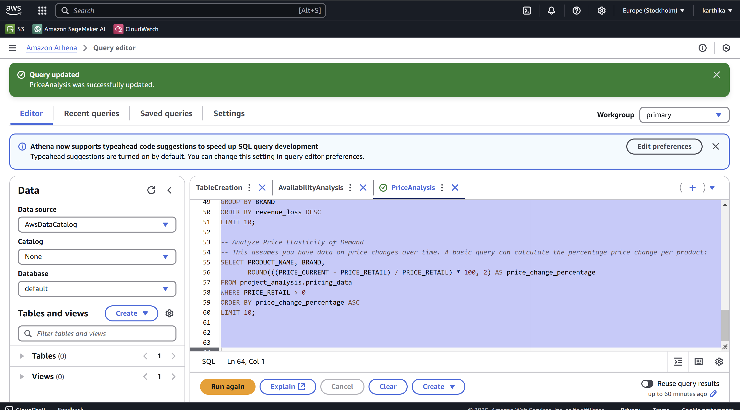
Price Optimization and Elasticity Analysis
AWS Athena

Slide 11
Price Optimization and Elasticity Analysis
Days 3-5: Visualization Phase
Tasks:
Data Preparation for Visualization:
Export Data for Visual Tools:
Save cleaned and feature-engineered data from Athena or local processing into a visualization-ready format (e.g., CSV, Parquet).
Upload to Visualization Tools:
Import the dataset into
Power BI, - DONE
Tableau, and - DONE
AWS QuickSight
for further analysis.

Slide 12
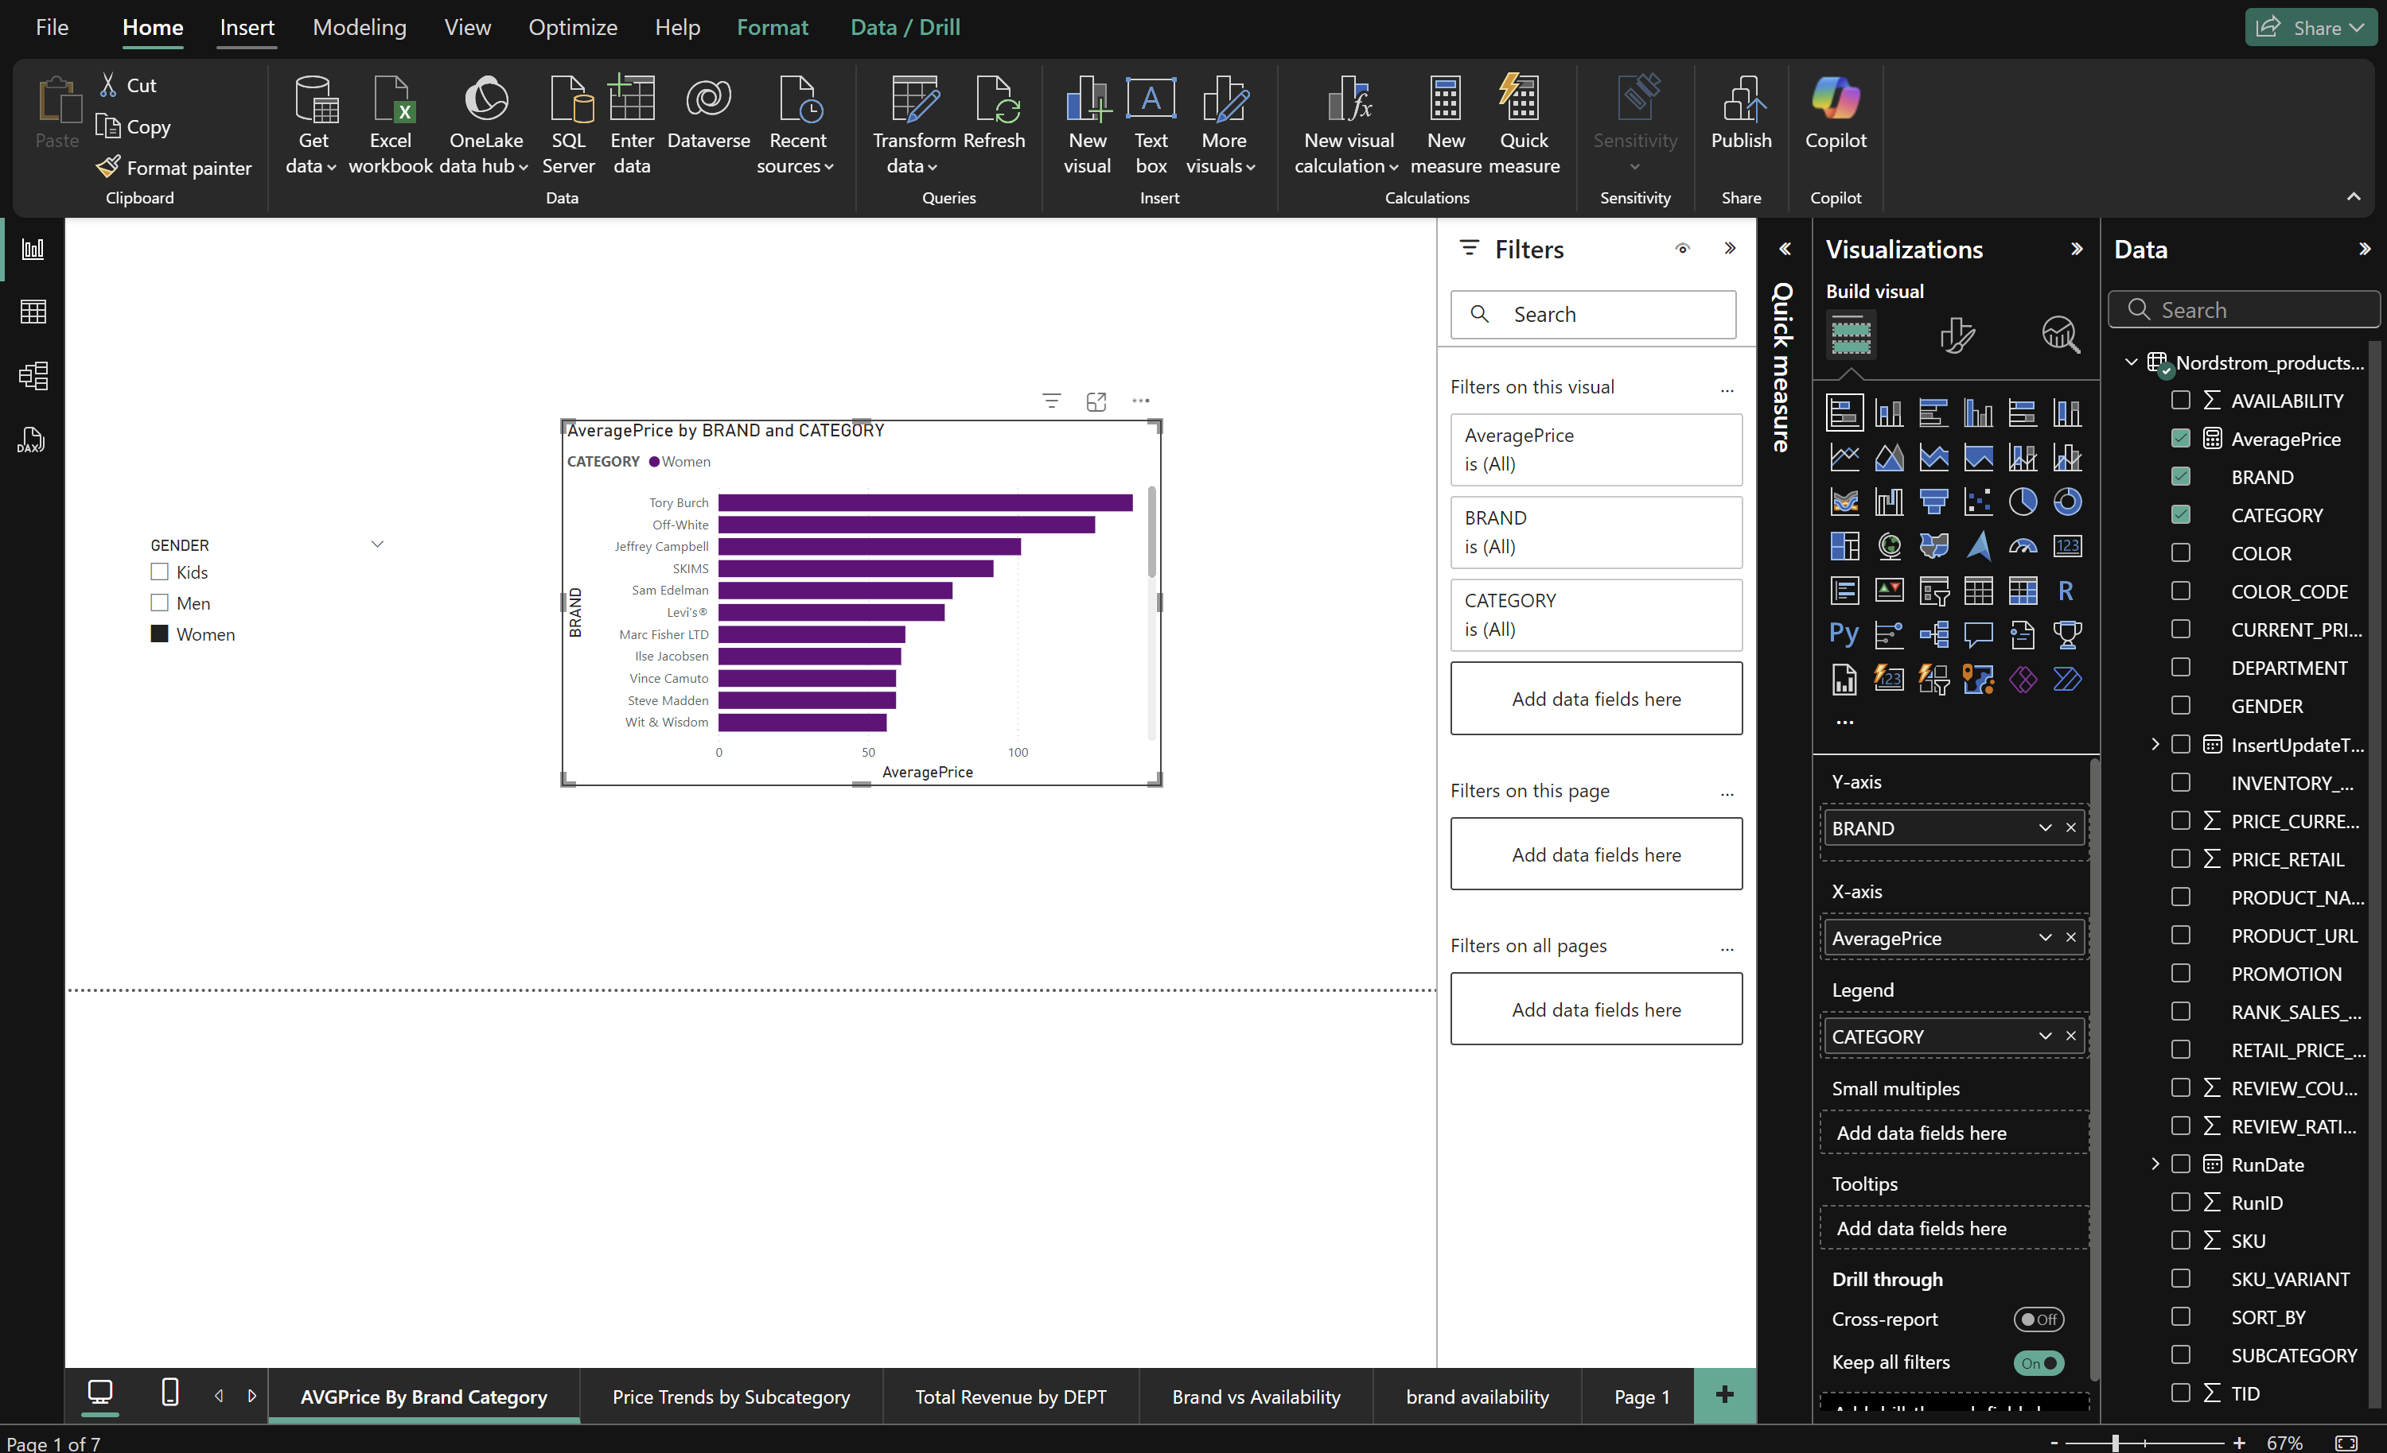
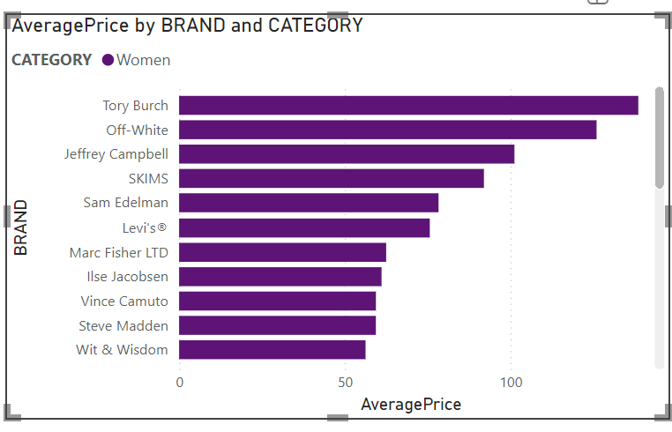
Price Optimization and Elasticity Analysis
PowerBI
Tasks:

Slide 13
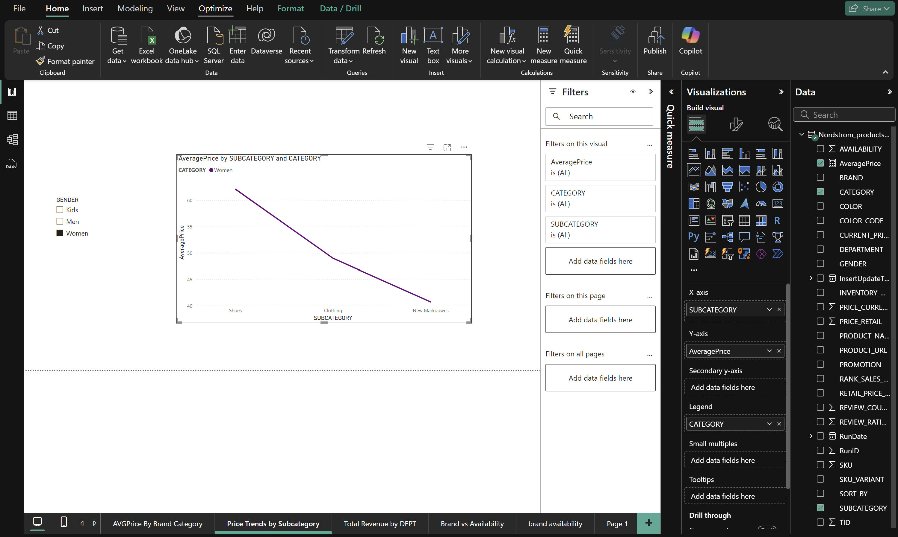
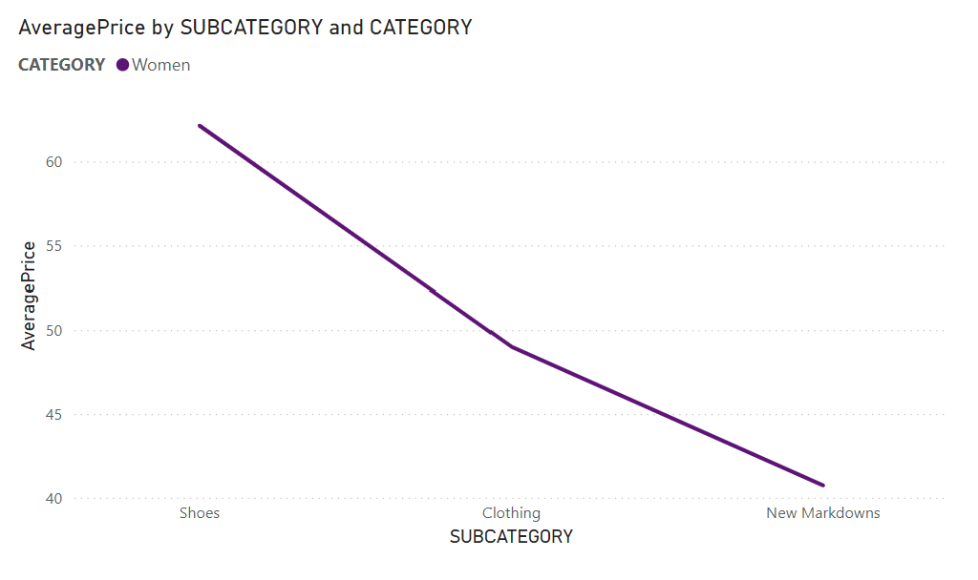
Price Optimization and Elasticity Analysis
PowerBI
Tasks:

Slide 14
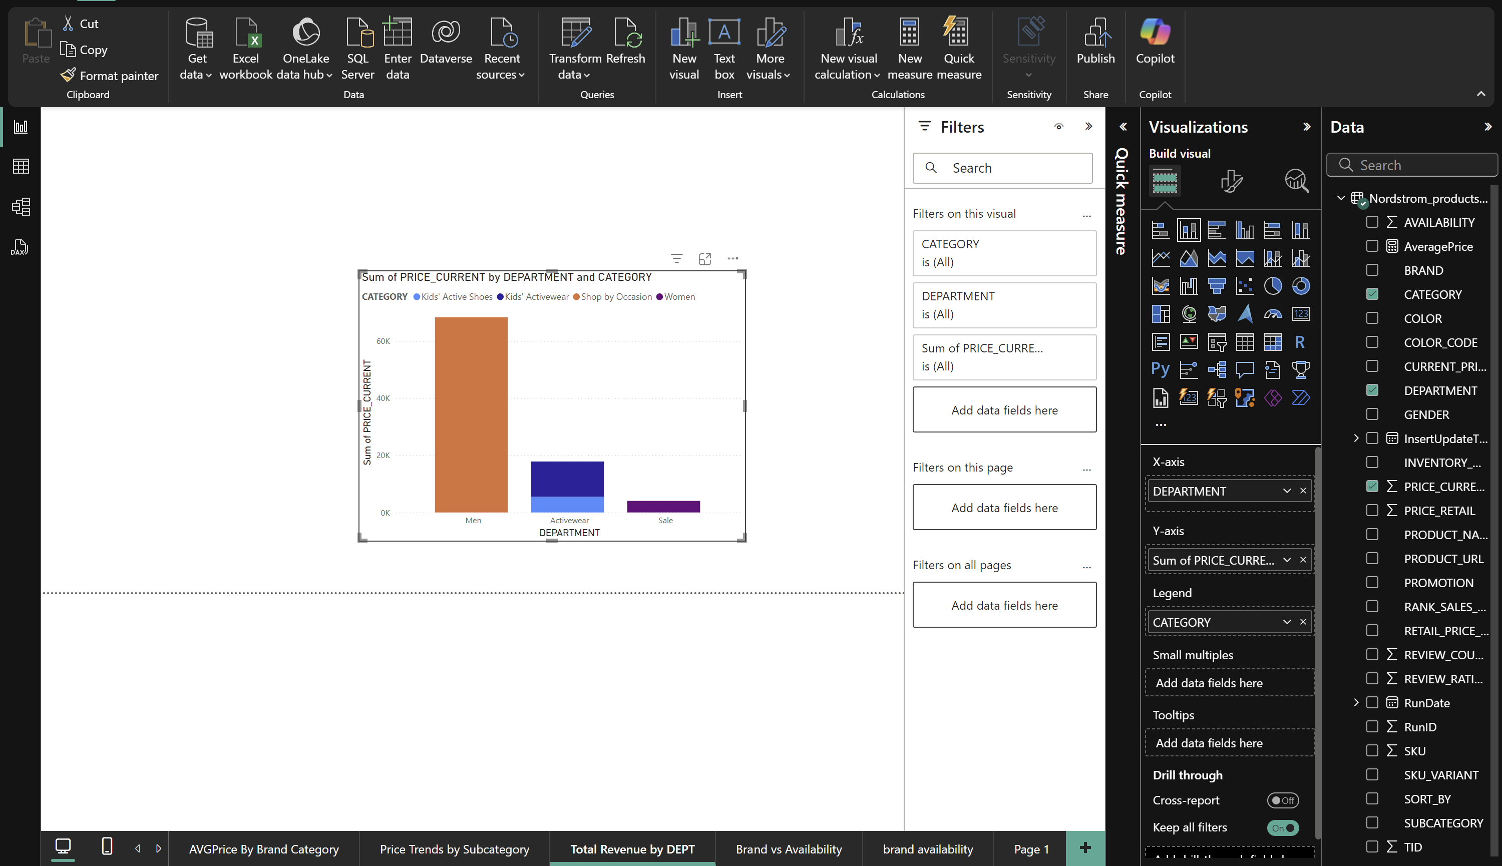
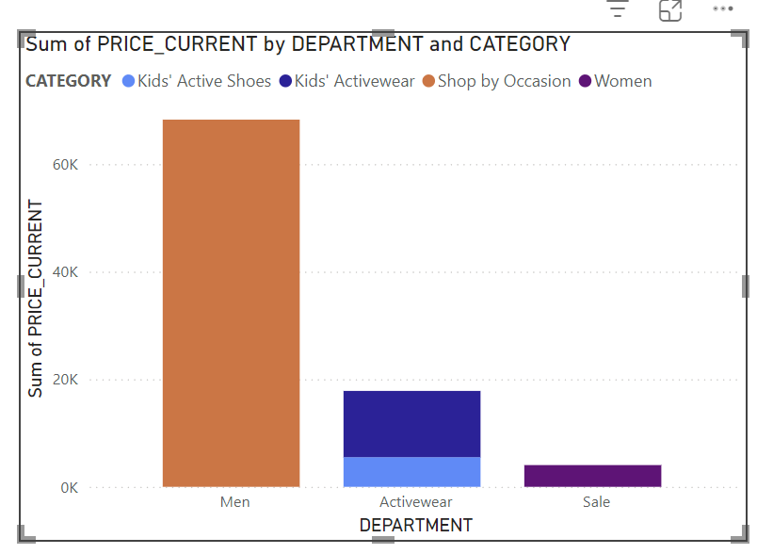
Price Optimization and Elasticity Analysis
PowerBI
Tasks:

Slide 15
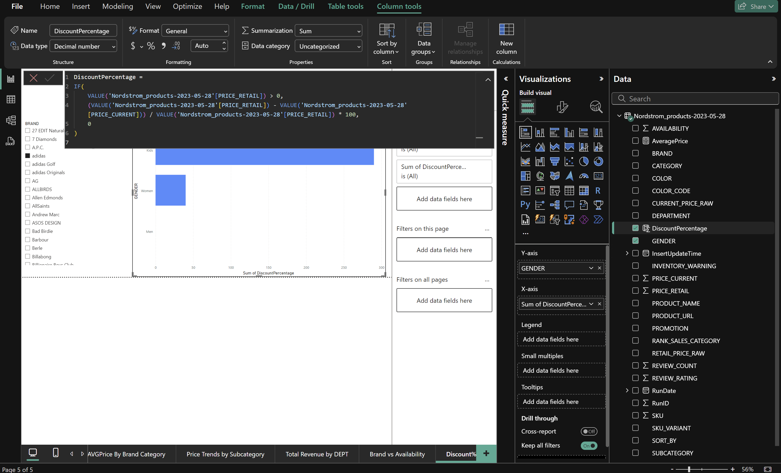
Price Optimization and Elasticity Analysis
PowerBI
Advanced Analytics with DAX (Data Analysis Expressions)
Calculating Discount Percentage

Slide 16
Price Optimization and Elasticity Analysis
PowerBI
Advanced Analytics with DAX (Data Analysis Expressions)
Calculating Discount Percentage

Slide 17
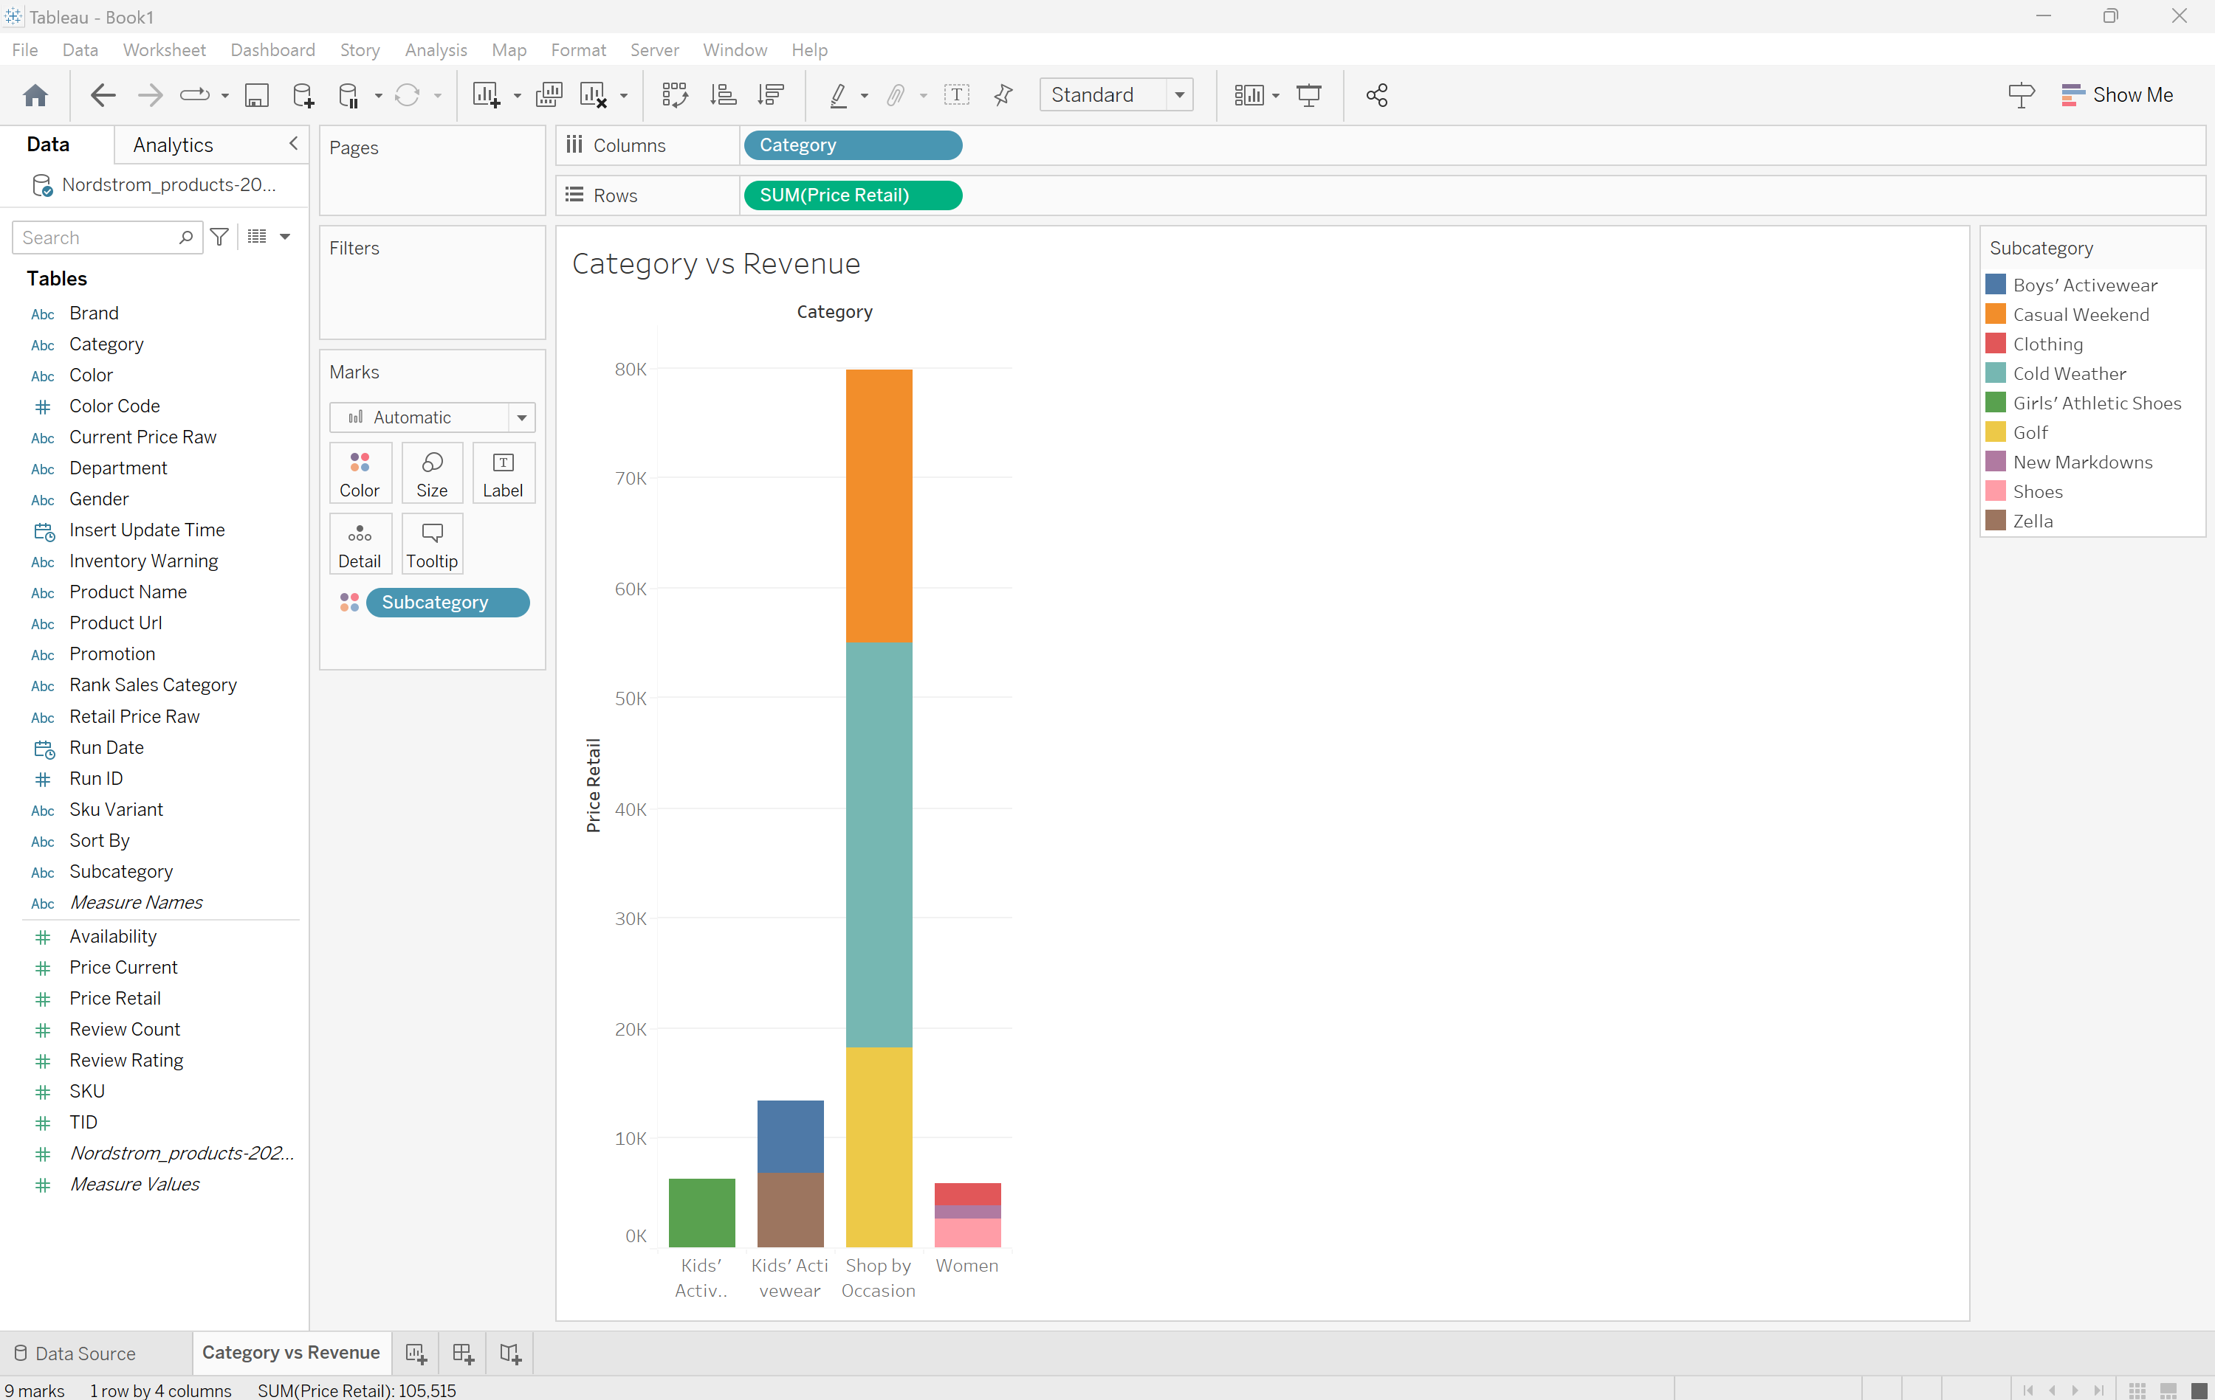
Price Optimization and Elasticity Analysis
Tableau:
Tasks:

Slide 18
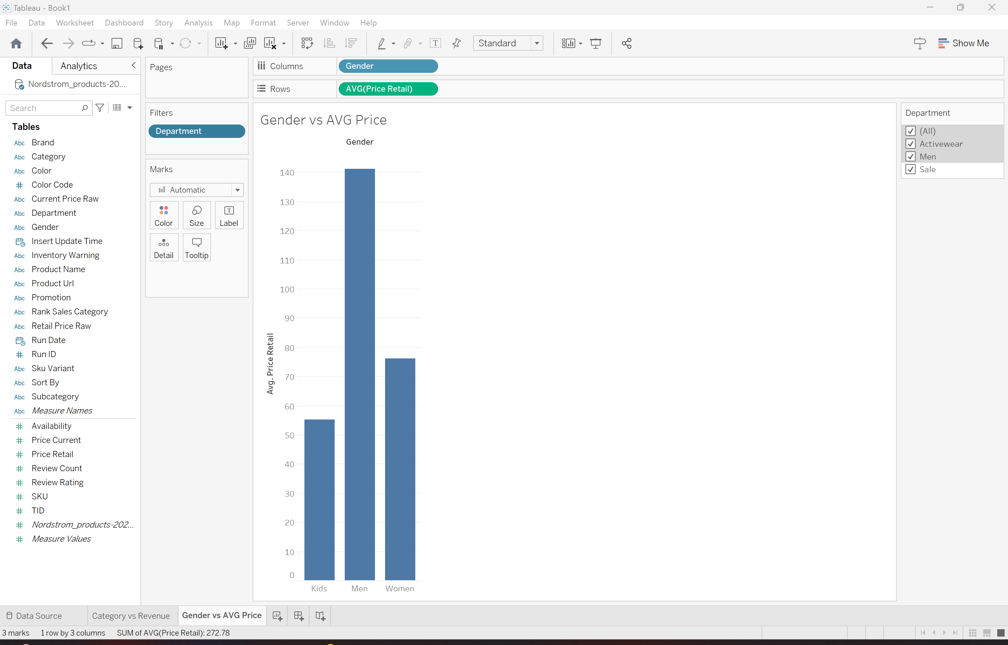
Price Optimization and Elasticity Analysis
Tableau:
Tasks:

Slide 19
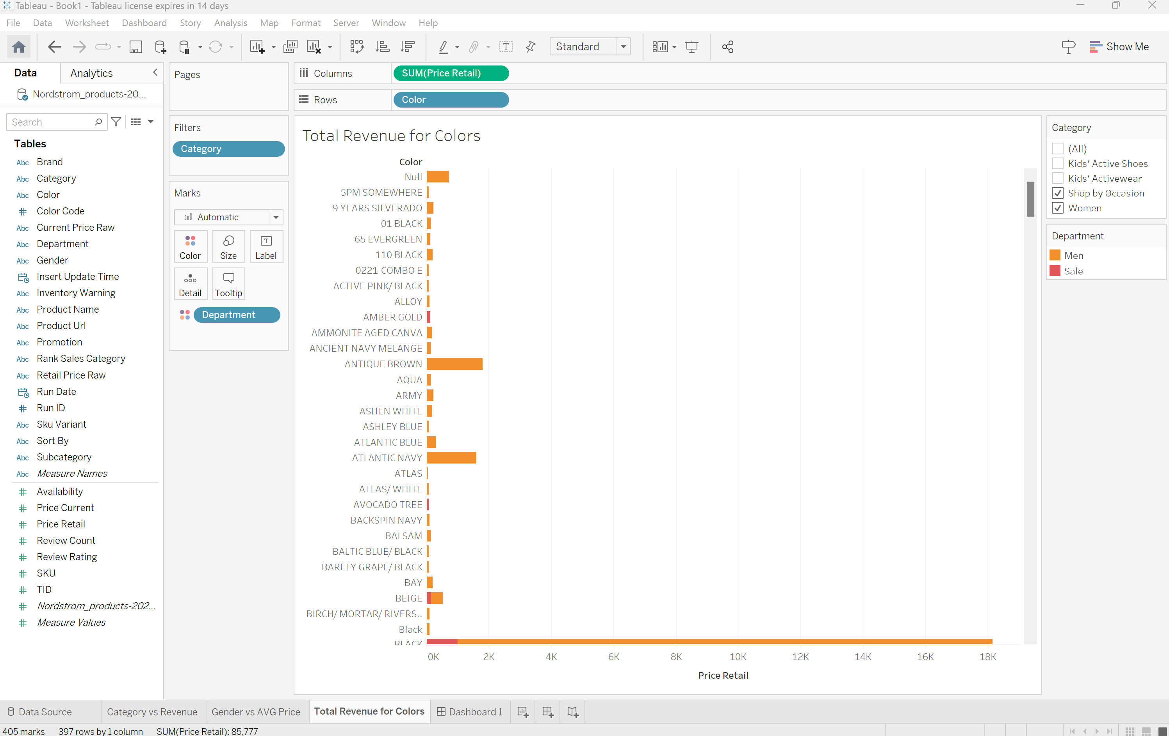
Price Optimization and Elasticity Analysis
Tableau:
Tasks:

Slide 20
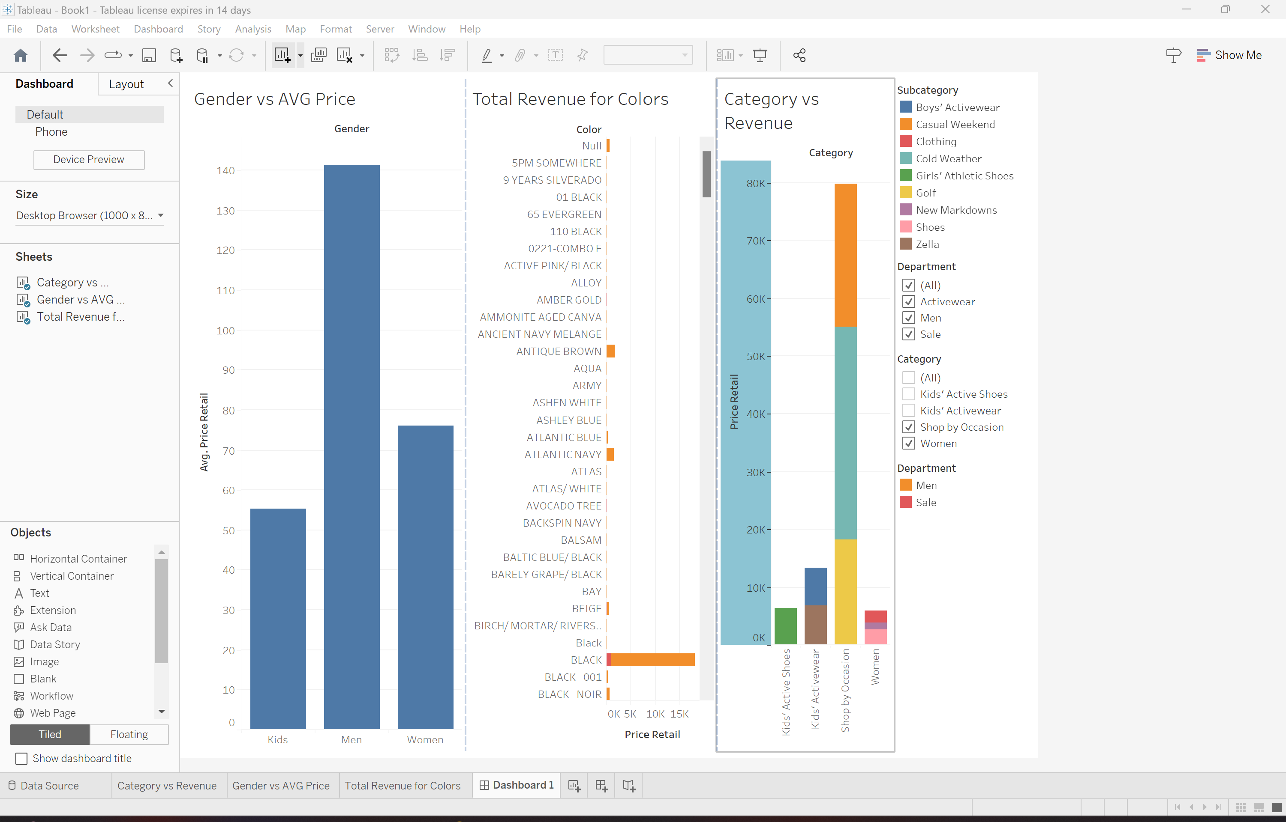
Price Optimization and Elasticity Analysis
Tableau:
Tasks:
Dashboard

Slide 21
Price Optimization and Elasticity Analysis
Days 6-8: Advanced Modeling and Deployment Phase
Tasks:
Data Analysis and Modeling with Google Colab:
Develop and Train Models:
Utilize Python libraries such as Pandas, NumPy, and Scikit-learn within Google Colab to perform data analysis and build machine learning models. - DONE
Save Trained Models:
Export the trained models for deployment purposes.

Slide 22
Price Optimization and Elasticity Analysis
Days 6-8: Advanced Modeling and Deployment Phase
Tasks:
Developing a Flask Application:
Set Up Flask Environment:
Install Flask and create a web application to serve the machine learning model.
Integrate Trained Model:
Load the saved model into the Flask application to handle predictions.

Slide 23
Price Optimization and Elasticity Analysis
Days 6-8: Advanced Modeling and Deployment Phase
Tasks:
Deploying Flask Application on AWS Lambda:
Package Application for AWS Lambda:
Use tools like Zappa to package the Flask application for deployment.
Deploy to AWS Lambda:
Deploy the packaged application to AWS Lambda, configuring API Gateway to route HTTP requests to the Flask application.

